Slide 1

Q-LEARNING CABS
THE DUO

Slide 2
INTRODUCTION
Q-Learning cabs are basically the self-driving cabs. The major goal is to demonstrate, in a simplified environment, how you can use Reinforcement learning (RL) techniques to develop an efficient and safe approach for tackling this problem.
The Q learning cab’s job is to pick up the passenger at one location and drop them off in another. Here are a few things that we'd love our cab to take care of:
Drop off the passenger to the right location.
Save passenger's time by taking minimum time possible to drop off.
Take care of passenger's safety and traffic rules.

Slide 3

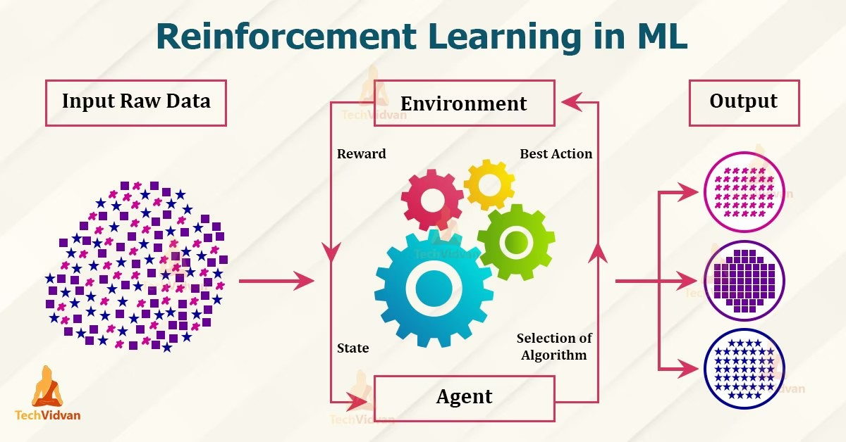
REINFORCEMENT LEARNING

Slide 4
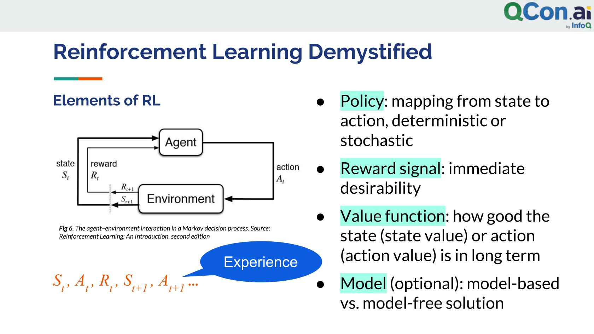
Q LEARNING
Q-Learning is a basic form of Reinforcement Learning which uses Q-values (also called action values) to iteratively improve the behaviour of the learning agent.
Terms related to Reinforcement learning:

Slide 5

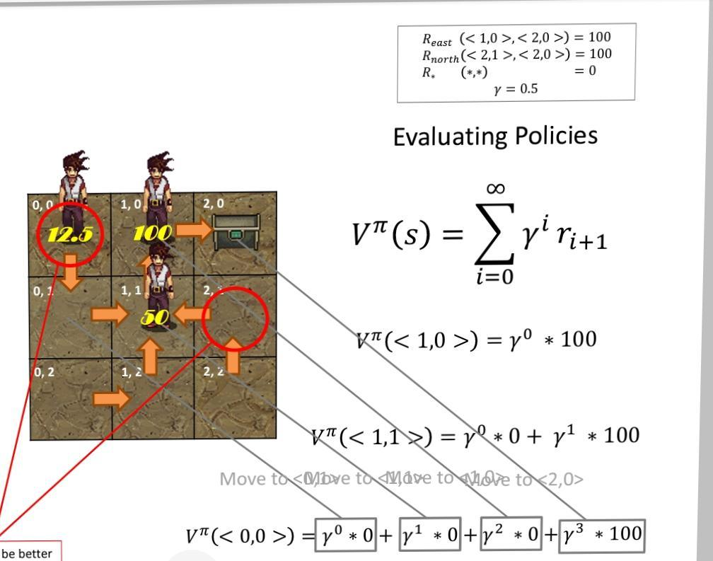
POLICIES

Slide 6
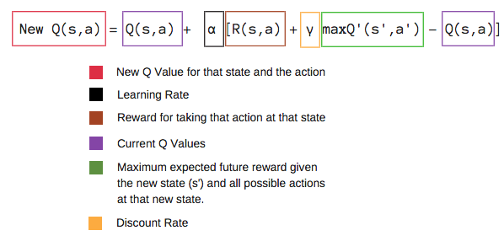
Mathematics of Q-Learning

Slide 7
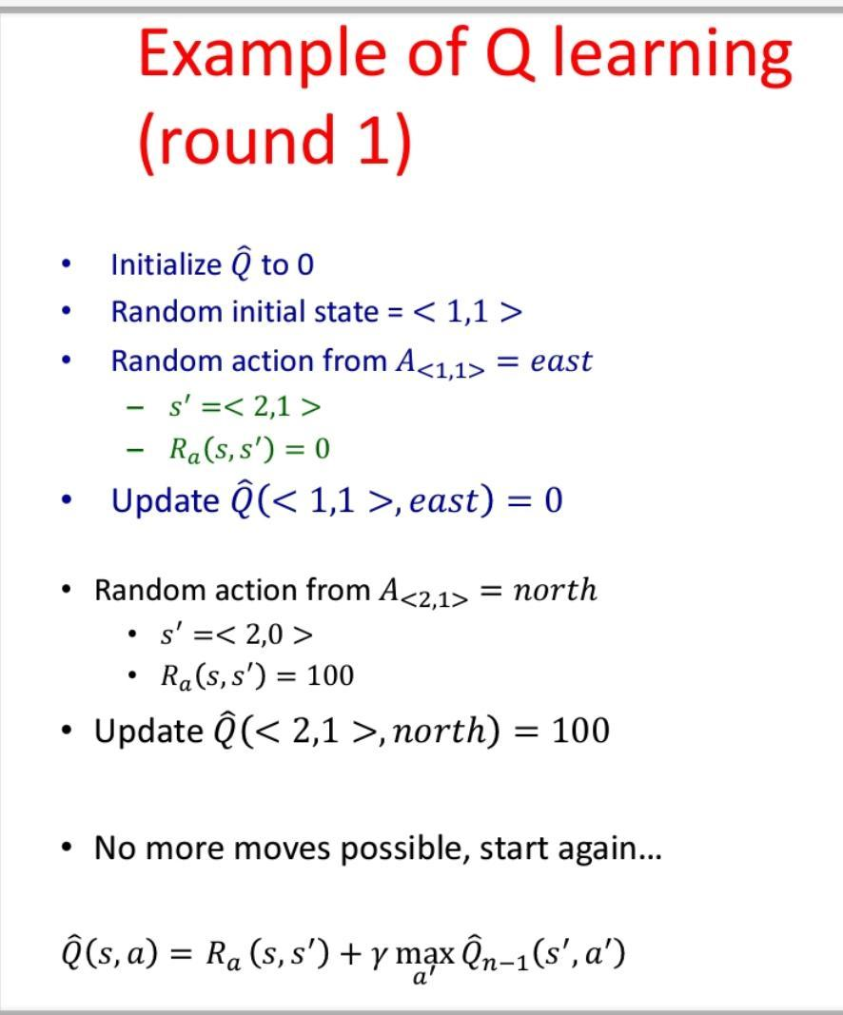
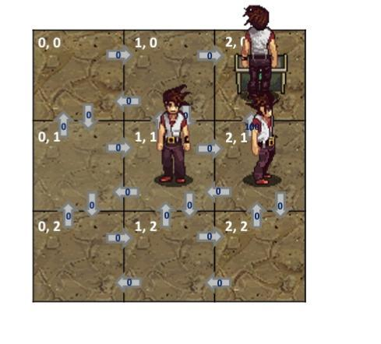

Slide 8
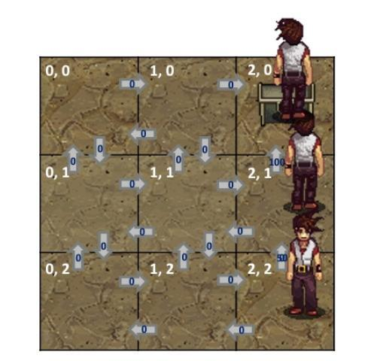
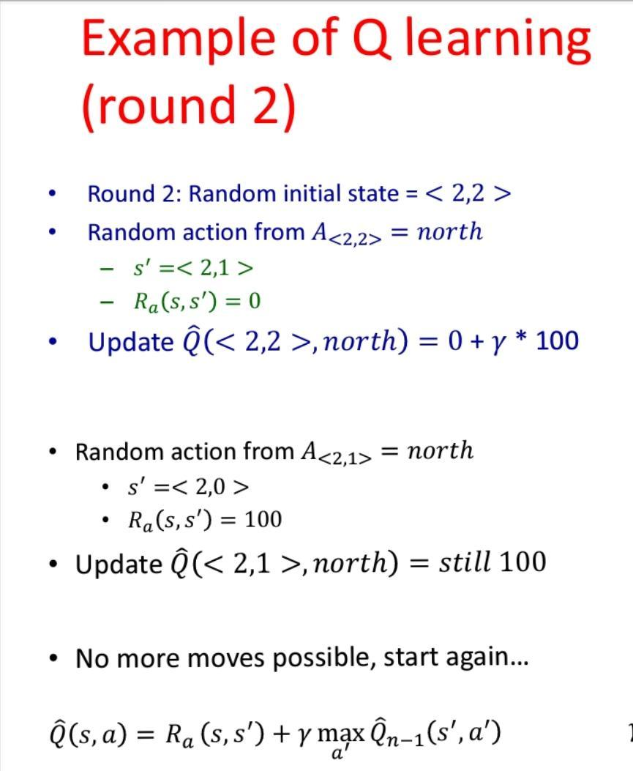

Slide 9
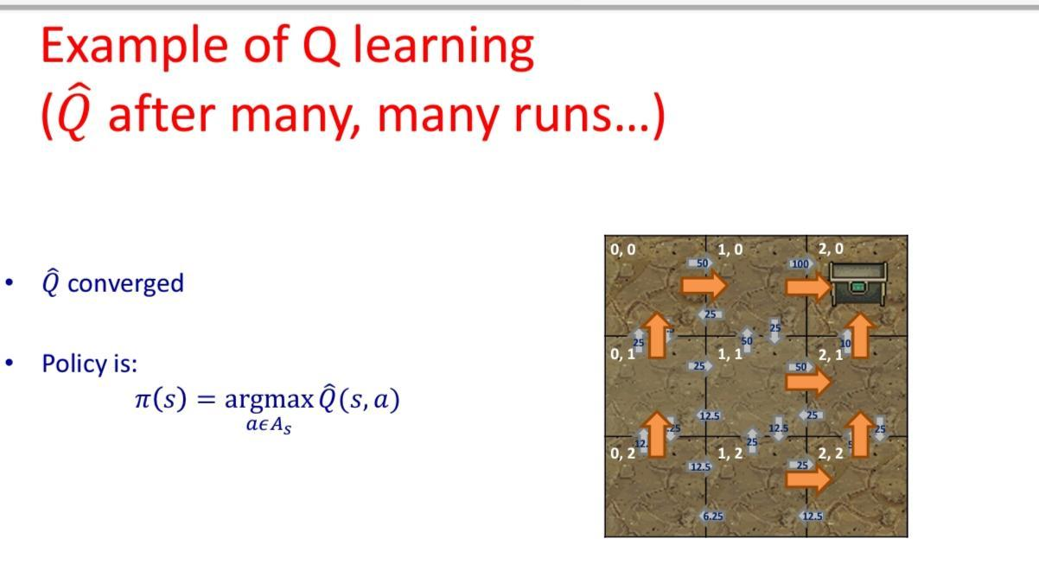

Slide 10

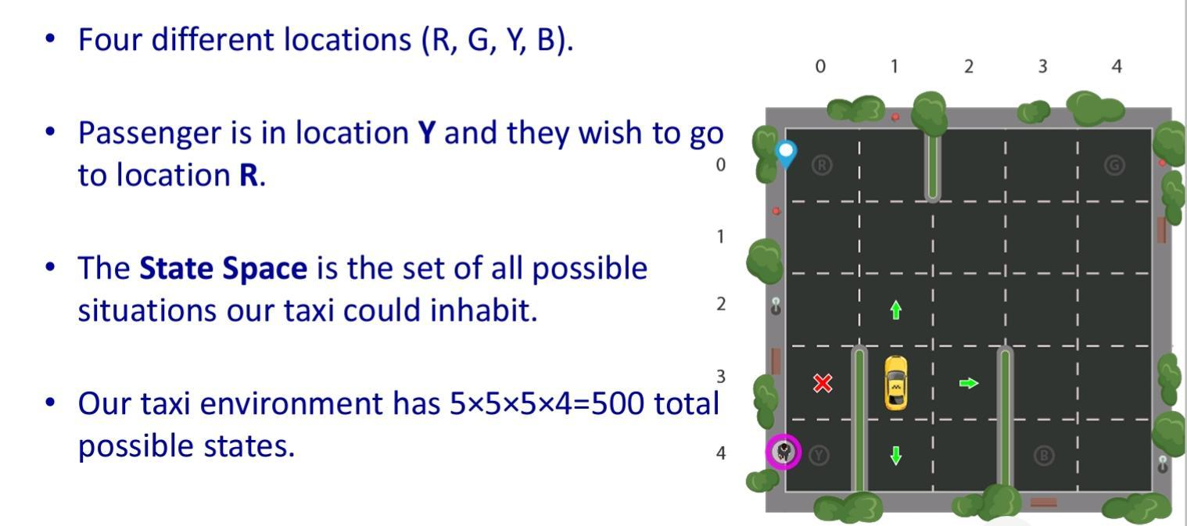
SELF DRIVING CARS

Slide 11
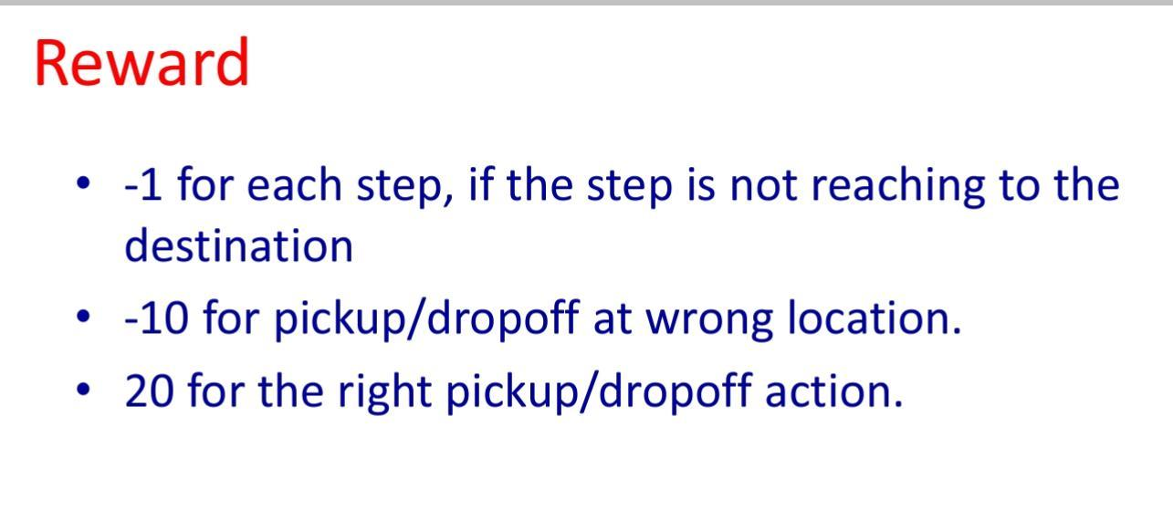

Slide 12
SOURCE CODE AND REFERENCES
CODE:
https://colab.research.google.com/drive/1RG8K7FknjynjoIKsf2a1Jsbiun0Z_Rjp#scrollTo=V1lGZpYCqYXu
REFERENCES:
https://drive.google.com/file/d/1rHD9ARBW4iB0iB28uxIQjK3dwIGYIzRR/view?usp=share_link
VIDEO: https://nitwarangal.webex.com/nitwarangal/ldr.php?RCID=49eebd315016a4a510205d0d3694b7f7 (Password: MLDSp123)
https://towardsdatascience.com/reinforcement-learning-teach-a-taxi-cab-to-drive-around-with-q-learning-9913e611028f

